Slide 1
Empowering with PrEP (E-PrEP): a peer-based online social network intervention to facilitate PrEP adoption among young Black/Latinx men who like men in New York City: pilot cluster randomized trial
Viraj Patel, MD, MPH, Division of General Internal Medicine, Albert Einstein College of Medicine Montefiore Health System, Bronx, New York, USA @DoctorPatel9
Nataly Rios, Sarit Golub, Keith Horvath, Chenshu Zhang, Kenneth Mayer, Ryung Kim, Sean Donegan,
Lawrence Gross, Yash Parekh, Zoe Ginsburg, Julia Arnsten
Background
Leveraging existing peer online social networks may be an effective and efficient approach to engage young Black/Latinx men who like men for health interventions
Developed and tested the feasibility, acceptability, and preliminary impact of a theory-based online social network intervention for PrEP adoption in a cluster randomized control trial
10th IAS Conference on HIV Science, Mexico City, July 2019
No Disclosures. Support: K23MH102118 (NIMH/NIH), Einstein-Rockefeller-CUNY Center for AIDS Research, P30AI051519 (NIH)
Notes:
The study was approved by the Einstein IRB and we took great care to ensure participant privacy. Took place between May-September 2017

Slide 2
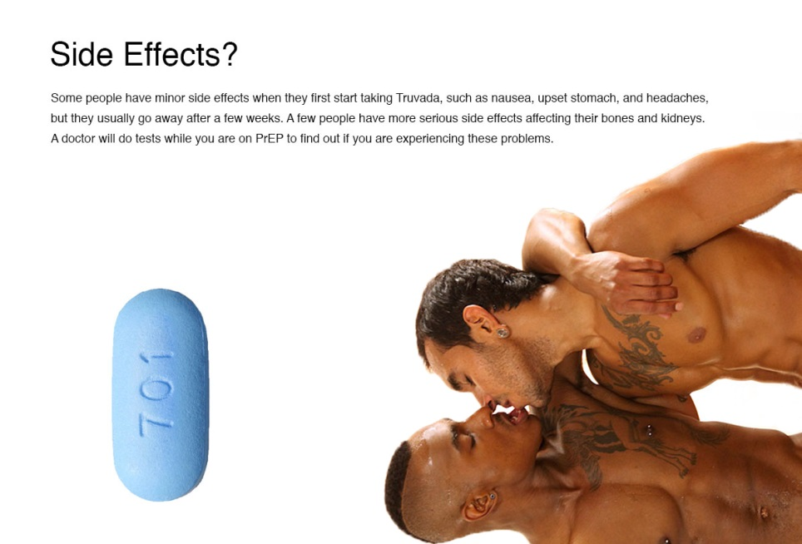
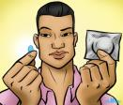
Methods
Recruited & randomized YMLM Peer Influencers (PIs)
PIs recruited participants from existing online networks
Participants completed online eligibility survey → joined Facebook/Instagram groups
Follow-up surveys at 6 and 12 weeks.
PIs conducted online campaign x 6-weeks, posted arm-specific contents
Eligibility:
HIV negative, sexually active MLM, Black/Latinx 18+, with elevated risk for HIV, living in New York City
Focus of online campaign:
E-PrEP: PrEP barriers/facilitators, care-engagement
Control: suicide, violence, depression, substance use, STIs (not HIV)
VV Patel et al, JMIR Research Protocols, 2018
Notes:
Guiding Principles: Used community based participatory research principals to develop an online behavioral intervention with Peer Leaders to address likely barriers and facilitators to PrEP use. Based on Diffusion of Innovation and Info-Motivation-Behavioral Skills Model.
Create a scalable and easily implementable peer-based intervention model

Slide 3
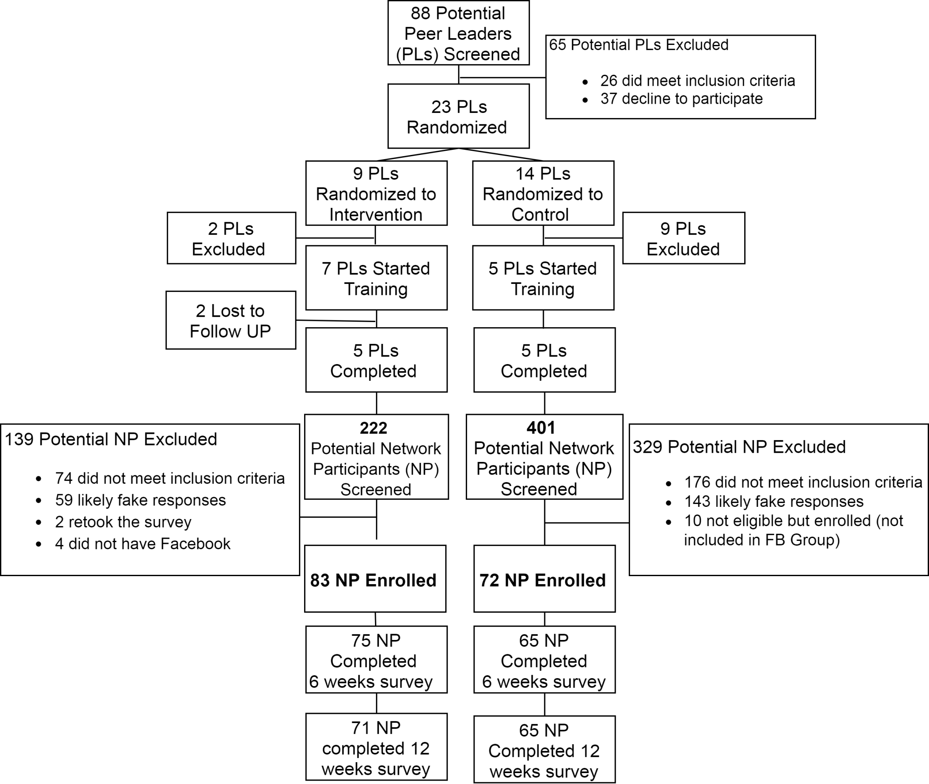
Results
Feasibility:
Rapid recruitment/enrollment
>90% Retention at 12 weeks
>85% liked, commented, loved $≥1$ post
Each post viewed by ~40-50% of participants
Peer Influencers
E-PrEP
Control
Acceptability:
82% would continue participating,
78% reported high satisfaction
75% would recommend friends to participate
Participants: N=155 enrolled)
Notes:
This first flow chart is our Consort diagram. We recruited PI screened 88 Peer Influencers

Slide 4
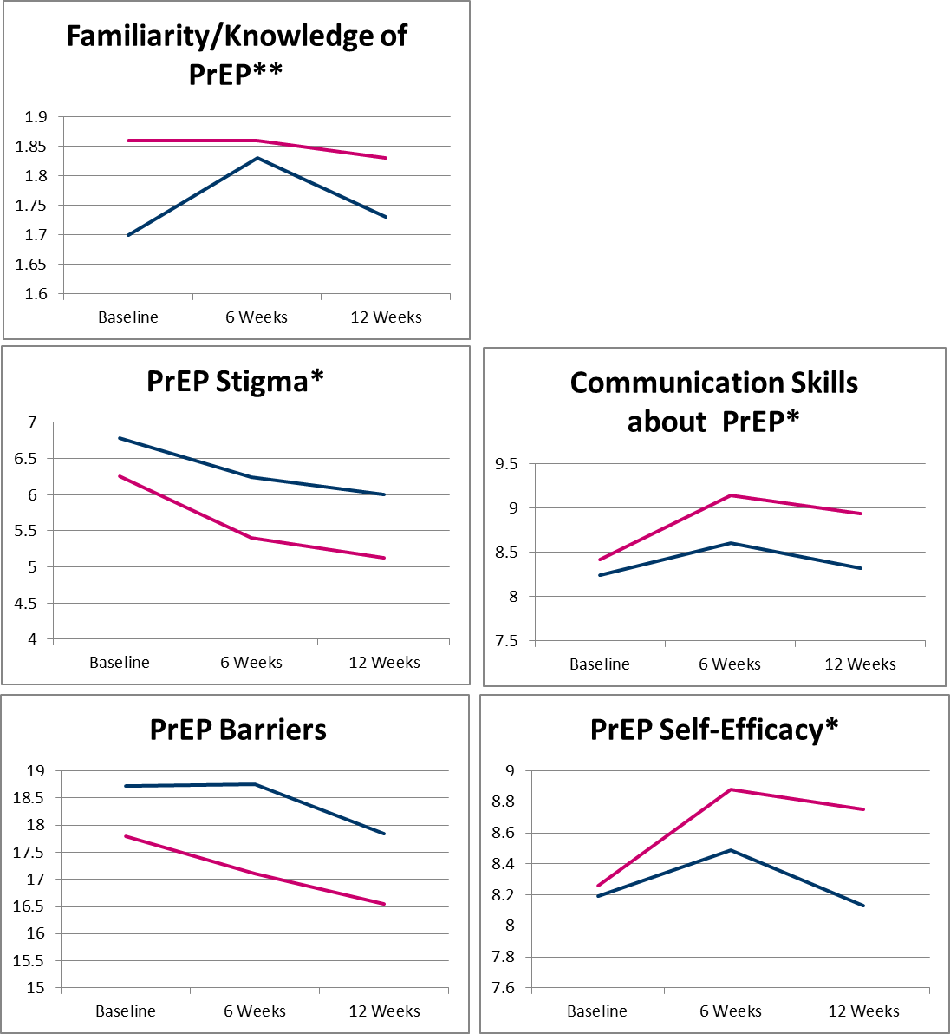
Results
Conclusions
A peer-developed online social-network intervention was highly feasible, acceptable, and efficient in engaging YBLMLM
E-PrEP intervention model may have utility for incorporation into programs to enhance PrEP uptake and persistence and engage on other health issues
A more intensive and fully powered campaign with longer follow-up is warranted.
New PrEP Starts at 12 wks:
E-PrEP: 4/52 (7.7%)
Control: 2/51 (3.9%). P=.21
*P<0.1. **P<0.05
E-PrEP mean score
Control mean score
@DoctorPatel9
Notes:
New PrEP Starts
6 Weeks 3/52 (5.7%) vs. 2/51 (3.9%)
12 Weeks 4/52 (7.7%) vs. 2/51 (3.9%)

